Slide 1
Additional Greek Adjectives and Pronouns
Prof. Vanessa Gorman
University of Nebraska-Lincoln
vgorman1@unl.edu

Slide 2
Remember what you learned already
Adjectives match the noun they modify in gender, number, and case
Adjectives do not necessarily have the same endings as the nouns they modify
Adjectives can act as an attribute, a predicate, or a substantive

Slide 3
ταχύς, ταχεῖα, τάχύ = swift **Most often seen in the adverbial accusative
SING | Masc | Fem | Neut | PLURAL | Masc | Fem | Neut
Nom | ταχύς | ταχεῖα | τάχύ |  | ταχεῖς | ταχεῖαι | ταχέα
Gen | ταχέος | ταχείας | ταχέος |  | ταχέων | ταχειῶν | ταχέων
Dat | ταχεῖ | ταχείᾳ | ταχεῖ |  | ταχέσι(ν) | ταχείαις | ταχέσι(ν)
Acc | ταχύν | ταχεῖαν | **τάχύ |  | ταχεῖς | ταχείας | ταχέα

Slide 4
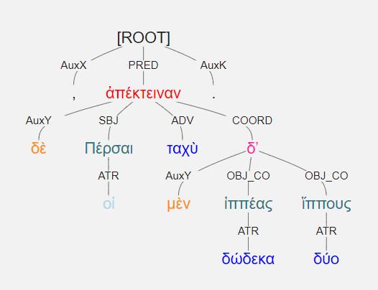
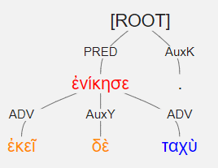
ἐκεῖ δὲ ταχὺ ἐνίκησε.
He conquered there quickly.
οἱ δὲ Πέρσαι ταχὺ δώδεκα μὲν ἱππέας, δύο δʼ ἵππους ἀπέκτειναν. [3.4.14]
The Persians quickly killed twelve horsemen and two horses.

Slide 5
εἷς and οὐδείς “One” and “no one”
Note: rough breathing and the accent on εἷς.
οὐδέν is often used adverbially (“not at all”)
 | masc | fem | neut |  | masc | fem | neut
Nom | εἷς | μία | ἕν |  | οὐδείς | οὐδεμία | οὐδέν
Gen | ἑνός | μιᾶς | ἑνός |  | οὐδενός | οὐδεμιᾶς | οὐδενός
Dat | ἑνί | μιᾷ | ἑνί |  | οὐδενί | οὐδεμίᾳ | οὐδενί
Acc | ἕνα | μίαν | ἕν |  | οὐδένα | οὐδεμίαν | οὐδέν

Slide 6
*τρεῖς and τέτταρες [“three” and “four”]
τέτταρες (Attic) = τέσσαρες
 | masc and fem |  | neut |  | masc and fem | neut
Nom | τρεῖς |  | τρία |  | τέτταρες | τέτταρα
Gen | τριῶν |  |  |  | τεττάρων
Dat | τρισί(ν) |  |  |  | τέτταρσι(v)
Acc | τρεῖς | τρία |  |  | τέτταρας | τέτταρα

Slide 7
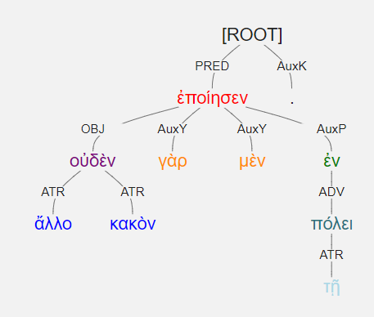
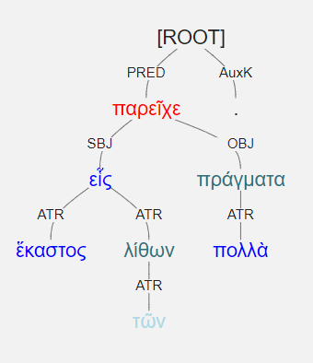
πολλὰ εἷς ἕκαστος τῶν λίθων πράγματα παρεῖχε. [2.4.27]
Each one of the rocks offered many problems.
οὐδὲν γὰρ μὲν ἄλλο κακὸν ἐποίησεν ἐν τῇ πόλει. [1.1.20]
For he did no other evil in the city.

Slide 8
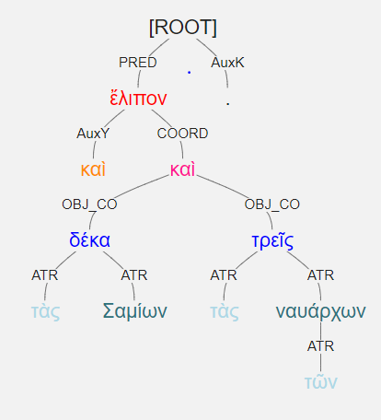
καὶ τὰς Σαμίων δέκα καὶ τὰς τῶν ναυάρχων τρεῖς ἔλιπον.
Note the feminine articles!
And they left ten [ships] of the Samians and three [ships]of the naurarchs.

Slide 9
πᾶς and ἅπας All, every, whole
Mixed-declension adjectives, built on two stems
M/N παvτ- using 3rd decl. endings
F πᾶσ- using 1st decl. endings
ἅπας is a strengthened form of πᾶς
all, every, whole
πᾶς | πᾶσα | πᾶν
παντός | πάσης | παντός
παντί | πάσῃ | παντί
πάντα | πᾶσαν | πᾶν
πάντες | πᾶσαι | πάντα
πάντων | πασῶν | πάντων
πᾶσι(ν) | πάσαις | πᾶσι(ν)
πάντας | πάσας | πάντα

Slide 10
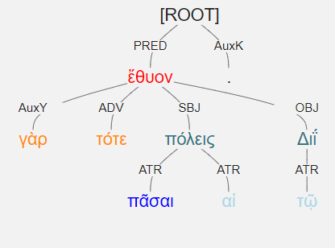
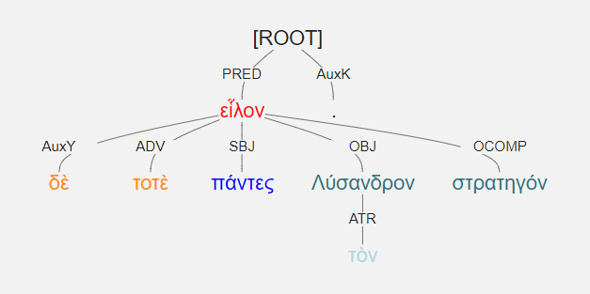
πᾶσαι γὰρ τότε αἱ πόλεις τῷ Διΐ ἔθυον.
For all the cities sacrificed to Zeus then.
εἷλον δὲ τοτὲ πάντες τὸν Λύσανδρον στρατηγόν.
Then all men chose Lysander as their general.

Slide 11
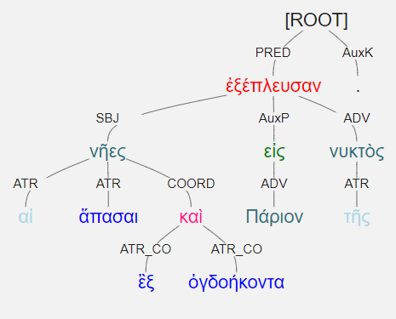
αἱ νῆες ἅπασαι εἰς Πάριον ἓξ καὶ ὀγδοήκοντα τῆς νυκτὸς ἐξέπλευσαν. [1.1.13]
All eighty-six ships sailed away at night to Parion.

Slide 12
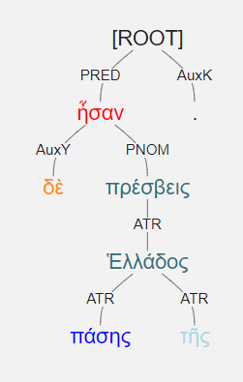
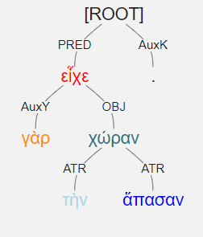
πάσης δὲ τῆς Ἑλλάδος πρέσβεις ἦσαν.
They were the envoys of the whole of Greece
εἶχε γὰρ τὴν χώραν ἅπασαν.
For he held the entire land.

Slide 13
τις (some, a certain)
Adjective or pronoun [someone/something]
Enclitic [no accent]
M/F = same
τι can mean “somehow”
τις | τι
τινος/του | τινος/του
τινι/τῳ | τινι/τῳ
τινα | τι
τινες | τινα
τινων | τινων
τισι(ν) | τισι(ν)
τινας | τινα

Slide 14
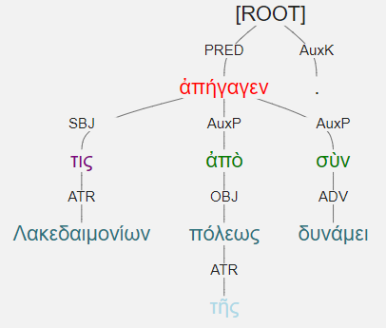
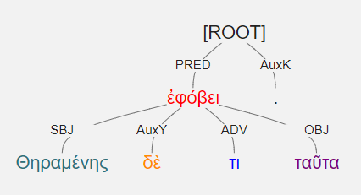
τις Λακεδαιμονίων ἀπὸ τῆς πόλεως σὺν δυνάμει ἀπήγαγεν.
Some Lakedaimonian led [them] out of the city in force.
Θηραμένης δέ τι ταῦτα ἐφόβει.
And Theramenes was somewhat afraid of these things.

Slide 15
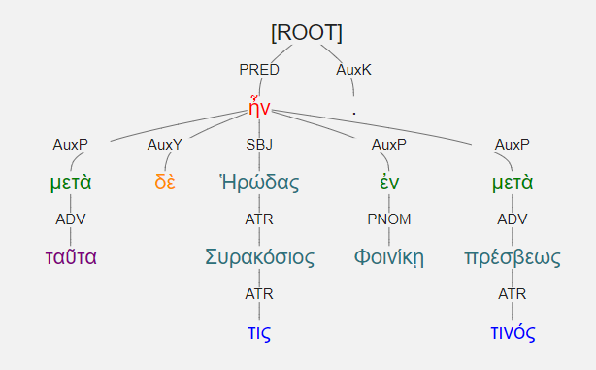
μετὰ δὲ ταῦτα Ἡρώδας τις Συρακόσιος ἐν Φοινίκῃ ἦν μετὰ πρέσβεως τινός. [3.4.1]
Afterwards, a certain Syracusan named Herodas was in Phoinikia with some envoy.

Slide 16
πολύς (many, much), μέγας (large, great)
Mixed-declension adjectives, built on two stems
Nom/acc singular masculine and neuter built on the shorter stem and declined as a 3rd decl. adj.
Everything else looks like a normal 3-ending adjective.
SING | many, much |  |  |  | SING | large, great
Nom | πολύς | πολλή | πολύ |  | Nom | μέγας | μεγάλα | μέγα
Gen | πολλοῦ | πολλῆς | πολλοῦ |  | Gen | μεγάλου | μεγάλης | μεγάλου
Dat | πολλῷ | πολλῇ | πολλῷ |  | Dat | μεγάλῳ | μεγάλῃ | μεγάλῳ
Acc | πολύν | πολλήν | πολύ |  | Acc | μέγαν | μεγάλην | μέγα
PLUR |  |  |  |  | PLUR
Nom | πολλοί | πολλαί | πολλά |  | Nom | μεγάλοι | μεγάλαι | μεγάλα
Gen | πολλῶν |  |  |  | Gen | μεγάλων
Dat | πολλοῖς | πολλαῖς | πολλοῖς |  | Dat | μεγάλοις | μεγάλαις | μεγάλοις
Acc | πολλάς | πολλάς | πολλά |  | Acc | μεγάλους | μεγάλας | μεγάλα

Slide 17
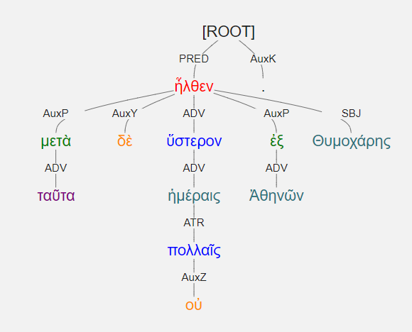
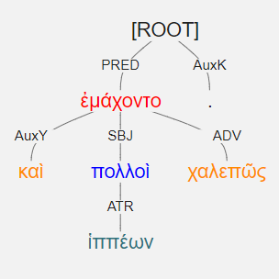
μετὰ δὲ ταῦτα οὐ πολλαῖς ἡμέραις ὕστερον ἦλθεν ἐξ Ἀθηνῶν Θυμοχάρης. [1.1.1]
Afterwards, not many days later, Thymochares came from Athens. [with dative of degree of difference]
καὶ πολλοὶ χαλεπῶς ἐμάχοντο ἱππέων.
And many of the horseman were fighting with difficulty. [with part. gen.]

Slide 18
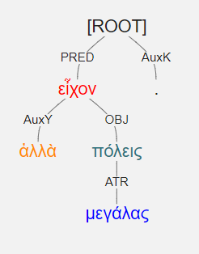
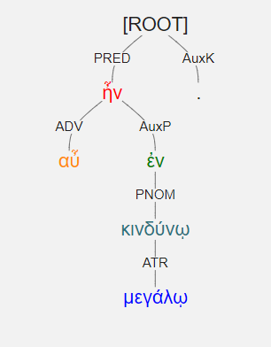
ἀλλὰ πόλεις εἶχον μεγάλας.
But they held great cities.
αὖ ἐν μεγάλῳ κινδύνῳ ἦν.
He was again in great danger.

Slide 19
1 | ἅπας | all, every | 75
2 | εἷς | one | 62
3 | ἐλάσσων | less | 33
4 | κράτιστος | strongest | 26
5 | μέγας | great | 98
6 | οὐδείς | no one | 178
7 | πᾶς | all, every, whole | 322
8 | πολύς | much, many | 454
9 | ταχύς | quick | 76
10 | τέσσαρες | four | 22
11 | τις | any, some, certain | 405
12 | τρεῖς | three | 33

